Slide 1

Objectives
In this session, you will learn to:
  Apply the basic concepts of static modeling
  Create class and object diagrams
Notes:
Initiate the session by explaining the session objectives to the students. Tell the students that before developing a software system, a developer needs to understand its physical structure. The physical structure of a software system consists of classes, objects, interfaces, and their relationships with each other. You can depict the physical structure by using static modeling, which includes class diagrams and object diagrams.

Slide 2
Applying the Basic Concepts of Static Modeling
In static modeling, you create:
  Class diagrams to represent classes, interfaces, collaborations, and their relationships.
  Object diagrams to represent the values of attributes for a specific instance of a class and the relationship among objects.
Notes:
Explain what class diagrams and object diagrams depict. Also explain the case study of BlueSeas group given in the student guide to introduce the need for static modeling. This case study will help you invoke student interest in static modeling.

Slide 3
Identifying Classes and Objects
You can derive classes and objects:
  From use cases of the software system.
  From responsibilities of the software system.
  By selecting all the nouns and noun phrases from the statements of the SRS document.
Notes:
Explain the different methods of identifying the classes and objects for a given problem statement. Use the BlueSeas Group case study to explain each of these methods.

Slide 4
Identifying Classes and Objects (Contd.)
Consider the following use cases for the customer information system for the BlueSeas group:
  Save Customer Information: Stores the information about customers, such as name, address, and contact number.
  Save Product Details: Stores the information about the product.
  Save Purchase Details: Stores the information about the purchase.
  Calculate Purchase Amount: Calculates the total cost of products purchased by a customer.
  Select Discount: Selects the discount to be offered based on the total cost of products purchased by the customer.
  Calculate Payable Amount: Deducts the discount from the total cost to obtain the amount payable by the customer.
Notes:
Explain the use cases given on the slide and the next slide to the students and ask them to identify the classes for the customer information system.

Slide 5
Identifying Classes and Objects (Contd.)
  Generate Bill: Generates a receipt for the amount payable by the customer.
  Accept Payment: Provides an interface on multiple counters to accept payment from customers.
Based on these use cases following classes can be identified:
  Customer: Maintains customer information.
  Product: Maintains the information about the product.
  PurchaseDetail: Maintains the information about the purchase and calculates the total amount of purchase.
  Discount: Selects the discount to be offered to a customer.
  Bill: Calculates the payable amount and, then, generates a bill for the customer.
  PaymentCounter: Defines the operations to calculate the payable amount and generate the bill to collect payment from the customer.
Notes:
Explain that the following classes can be identified from the information about use cases given here:
Customer
Product
PuchaseDetail
Discount
Bill
PaymentCounter

Slide 6
Creating Class and Object Diagrams
Static Modeling technique is used to depict the static constituents of a software system.
Class diagrams and Object diagrams are the Static Structure Models that are required to represent the static constituents of a software system.
Class diagrams are used to represent the classes, attributes and the relationship between these classes whereas Object diagrams are used to represent the instance of these static constituents.
Notes:
Explain the concept of Class and Object Diagrams.

Slide 7
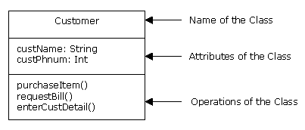
Introducing Class Diagrams
UML provides a class notation to represent classes in class diagrams.
The class notation has three compartments:
  The first compartment depicts the name of the class.
  The second compartment depicts the attributes of the class.
  The third compartment depicts the operations of the class.
Notes:
Explain the UML notation for a class by using the figure given on the slide.

Slide 8
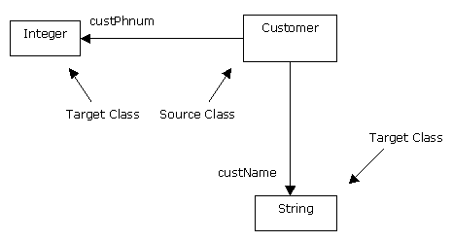
Introducing Class Diagrams (Contd.)
The attributes of a class can also be depicted as an association.
Notes:
Use the figure given on the slide to explain that an attribute can be represented as a solid line connecting two classes, where the source class is the class name and the target class is the data type class. The name of the attribute is stated at the target end of the association.

Slide 9
Introducing Class Diagrams (Contd.)
You can use class notation to:
  Analyze the requirements of the system. At the analysis level, the class notation depicts only the attributes and operations.
  Implement the requirements of the system at the implementation phase. At the implementation level, the class notation depicts attributes, operations, and their visibility.
Visibilities for attributes and operations of a class are:
  + : Indicates that the attribute or operation is visible to other classes.
  - : Indicates that the attribute or operation is not visible to other classes.
  # : Indicates that the attribute or operation in the base class is visible to derived classes.
  ~: Indicates that the attribute or operation is visible to classes, which are within the same package.
Notes:
Explain that class diagrams are used for both analysis and implementation. Explain that at the implementation level, visibility of attributes and operations is also specified. Explain the meaning of visibility. Next, explain the symbols used for depicting different types of visibilities. Finally, explain with an example, how the visibility of attributes and operations is specified in a class notation.

Slide 10
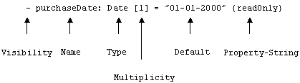
Introducing Class Diagrams (Contd.)
Syntax for Attributes:
  Syntax for depicting an attribute in a class diagram:
  visibility name: type multiplicity = default (property–string)
  Example:
Notes:
Explain the syntax of depicting attributes in a class diagram by using the example given on the slide.

Slide 11
Introducing Class Diagrams (Contd.)
Syntax for Operations:
  Syntax for representing operations in a class diagrams:
  visibility name (parameter-list):
  return-type (property-string)
  Example of a class:
Data Type
Property String
Name of Attribute
Default Value
Multiplicity
PurchaseDetails
Visibility
-purchaseDate: Date [1…*] = "01-01-2000" {ReadOnly}
-productID:Int[1…*]
-custID:Int[1]
-quantity:Int[1…*]=0
Visibility
+caluculateTotalAmt():Float
+generatePurchaseList(prodID:Int): String
Data Type
Name of Operation
Name of Parameter
Return Type
Notes:
Explain the syntax for representing operations in a class diagram by using the example given on the slide.

Slide 12
Just a minute
Which of the following visibilities provided by UML indicates that the attribute/operation in the base class are protected?
  +
  -
  #
  ~
Answer:
  #
Notes:
Check the learning of the students by asking the question given on the slide.

Slide 13
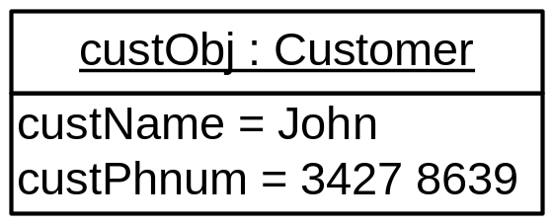
Introducing Object Diagrams
Object diagrams represent the instances of static elements, that is, classes.
Object diagram is represented as a rectangular box with two compartments.
Notes:
Explain the structure of an object in an object diagram by using the example given on the slide.

Slide 14
Representing Relationships in Class and Object Diagrams
Relationships indicate the way in which the elements of a software system connect to each other logically and physically.
The various relationships between classes and objects are:
  Association
  Dependency
  Generalization
  Realization
Notes:
Explain the meaning of relationships between the elements of a software system. Also, list the various types of relationships.

Slide 15


Representing Relationships in Class and Object Diagrams (Contd.)
Association relationship:
  Represents the static relationship shared among objects of two classes.
  An attribute of the association relationship is multiplicity.
  Multiplicity represents the number of objects of a class that are connected to an object of another class.
Customer
Has
Address
Notes:
Explain bi-directional and unidirectional association relationship by using the figures given on the slide.

Slide 16
Representing Relationships in Class and Object Diagrams (Contd.)
  The four types of multiplicity relationships are:
    Exactly one (1): Specifies that only one object of a class is related to object/s of another class.
    One or zero (0..1): Specifies that zero or one object of a class is related to object/s of another class.
    Many (0..*): Specifies that zero or many objects of a class are related to object/s of another class.
    One or more (1..*): Specifies that one or many objects of a class are related to object/s of another class.
Notes:
Explain the meaning of multiplicity by using the example given on the slide. Also explain the four types of multiplicity relationships.

Slide 17


Representing Relationships in Class and Object Diagrams (Contd.)
  Association relationship is of two types:
    Aggregation: Represents an association between two classes such that class A is a part of class B and class A can exist independently.
    Composition: Represents an association between two classes such that class A contains class B and also controls the lifetime of class B.
Notes:
Explain aggregation and composition as special types of association relationships. Explain the concept of aggregation and composition by using the figures given on the slide.

Slide 18

Representing Relationships in Class and Object Diagrams (Contd.)
Dependency relationship:
  Represents the semantic relationship between two classes such that a change in the attributes and operations of one class affects the attributes and operations of the other class.
Notes:
Explain dependency and generalization by using the examples given on the slide.

Slide 19
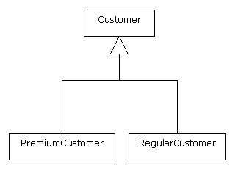
Representing Relationships in Class and Object Diagrams (Contd.)
Generalization relationship:
  Represents how super classes are related to the sub classes.
Notes:
Explain dependency and generalization by using the examples given on the slide.

Slide 20

Representing Relationships in Class and Object Diagrams (Contd.)
Realization relationship:
  Represents the semantic relationship among the components of a class diagram, where one component specifies a contract and the other component implements the contract.
Notes:
Explain the concept of realization by using the example given on the slide.
When you explain the various types of relationships to students, they may get confused among relationships, such as dependency, generalization, and realization. You should explain the concepts with the help of examples to enable the students to identify the relationships with real-life scenarios.
Dependency is defined as a relationship in which a change in an element causes a change in the other elements. By this definition, association, generalization, and realization are also dependencies but these relationships have their own representation and notation. For this reason, these relationships are not considered as dependencies. In an association relationship, a change in the elements of a class causes a change in the elements of the associated classes also. Similarly, in generalization, any change in the attributes and operations of general classes leads to a change in the attributes and operations of special classes. In realization, if the specification of the contract changes, the elements of implementing a class also change.

Slide 21
Just a minute
Which of the following represents the semantic relationship between two classes such that a change in the attributes and operations of one class affects the attributes and operations of the other class?
  Generalization
  Dependency
  Realization
  Aggregation
Answer:
  Dependency
Notes:
Check the learning of the students by asking the question given on the slide.

Slide 22

Depicting a Class Diagram for the Customer Information System
Consider the following class diagram that depicts the relationship among classes for the customer information system:
Notes:
Reiterate the BlueSeas Group case study and explain how the class diagram for that case study can be created by using the class diagram given in the embedded Word document.
Students may come across the terms, responsibilities of classes and reference attributes. To explain these terms to students, refer to the following information.
Responsibilities of a Class
The responsibilities of a class are defined as a set of functions that the class provides. Classes need methods to implement their responsibilities. A class can have the following types of responsibilities:
* Doing: Includes the functions that a class performs to initiate a function in other classes. For example, the Customer class requests for a bill. This initiates the generateBill() operation of the Bill class.
* Knowing: Includes the functions that the class provides to obtain the value of derived attributes and private encapsulated data. For example, the getCustName() operation of the Customer class is used to obtain the name of the customer when the visibility of the CustName attribute is private.
Reference Attribute
A reference attribute is an attribute that refers to the object of another class. A reference attribute of a class is not explicitly shown in the design of a class diagram. It is derived from the association relationship shared by the two classes. Consider the example of two classes, SalesList and Product, which share a many to one multiplicity relationship between each other. The Product class stores the description of several products. The SalesList class contains a list of various sold products. The following figure shows the relationship between the SalesList and Product classes and the implementation of the reference attribute in the SalesList class.
<<<<<<INSERT FIGURE>>>>>>>
Note that in the preceding figure, an instance variable of the Product class has been created in the SalesList class. However, the instance variable is not explicitly declared as an attribute in the attribute section of the SalesList class. A common definition for reference attributes is, “Reference attributes have suggested association and navigability in a class diagram”. Mapping this definition to the class diagram, note that there is a suggested attribute visibility indicated by the association and navigability explicitly defined as an attribute during the code generation phase.

Slide 23
Summary
In this session, you learned that:
  Static modeling involves identifying the static elements and their relationships to depict the static structure of the software system.
  The class and object diagrams are created to model the static structure of a software system.
  The class diagram notation represents the name, attributes, and operations of a class.
  The instances of the class diagram elements and their relationships need to be identified in order to create object diagrams. Instances refer to the objects of the software system.
  The object diagram notation represents the name and attributes of the object. It also includes the name of the class and the values of the attributes for a specific instance.
Notes:
Summarize the session by using the summary points given in the slide.

Slide 24
Summary (Contd.)
  The various types of relationships shared by objects and classes are:
    Association
    Dependency
    Generalization
    Realization
Notes:
Summarize the session by using the summary points given in the slide.

